Slide 1

Entertainer Data Analytics
Unified Mentor Data analytics Internship Project
T Shiva Kumar Yadav

Slide 2

Overview
By leveraging data analytics techniques, the project aims to provide actionable insights into entertainer preferences, audience demographics, performance trends, and audience satisfaction.

Slide 3



Tools and Technologies
Language: Python
Libraries : Pandas, Numpy, Matplotlib, Seaborn
Environment: Jupyter notebook

Slide 4
Deliverables:
Jupyter Notebook with code and explanations.
Visualizations showcasing segmentation and insights.
Concise report summarizing analysis and recommendations

Slide 5
Details of data
Columns: Entertainer', 'Gender (traditional)', 'Birth Year', 'Entertainer', 'Year of Breakthrough/#1 Hit/Award Nomination', 'Breakthrough Name', 'Year of First Oscar/Grammy/Emmy', 'Entertainer', 'Year of Last Major Work (arguable)', 'Year of Death’
Range Index: 70 entries, 0 to 69

Slide 6
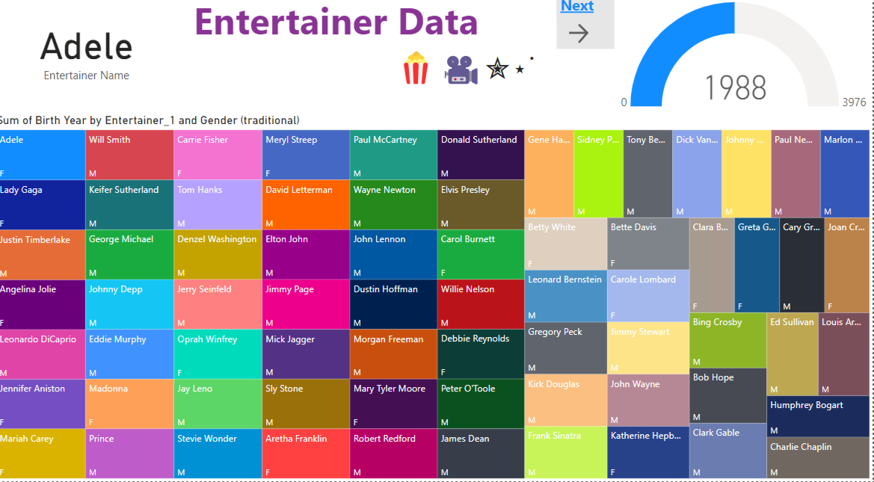
My Dashboards Using Power Bi:

Slide 7
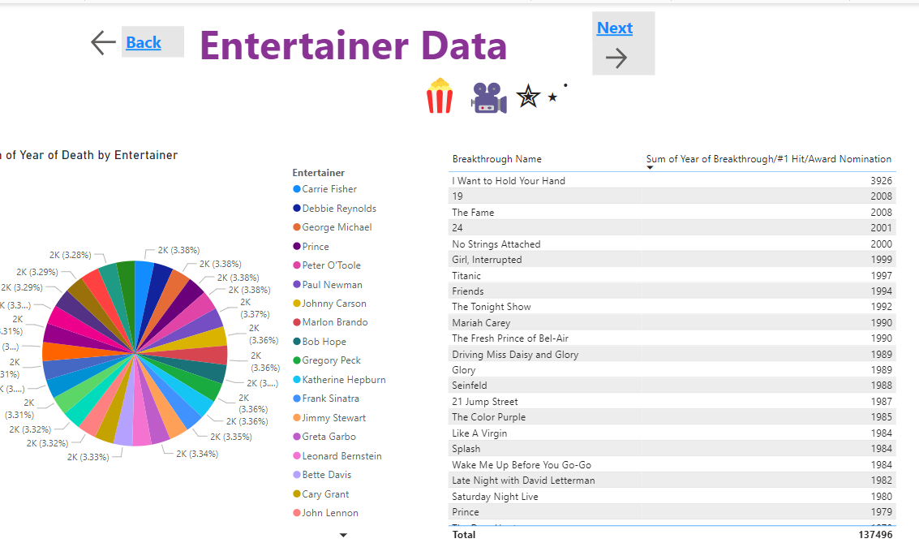

Slide 8
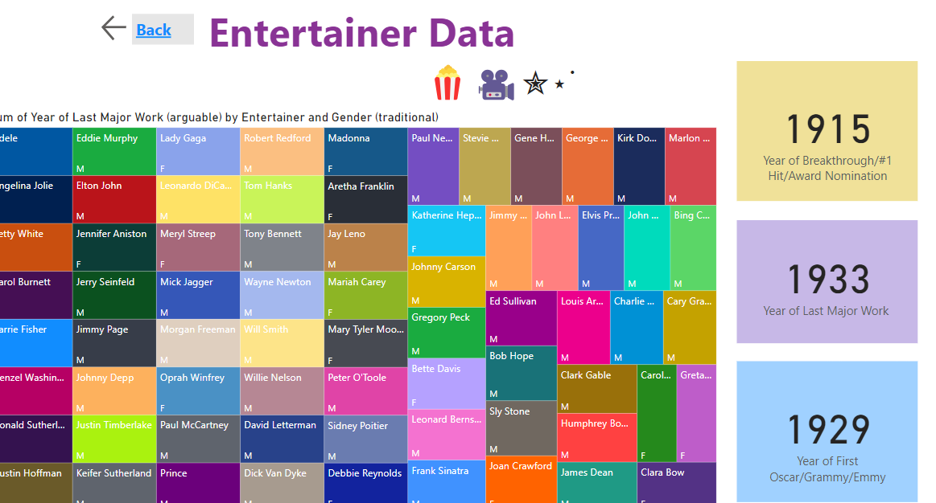

Slide 9
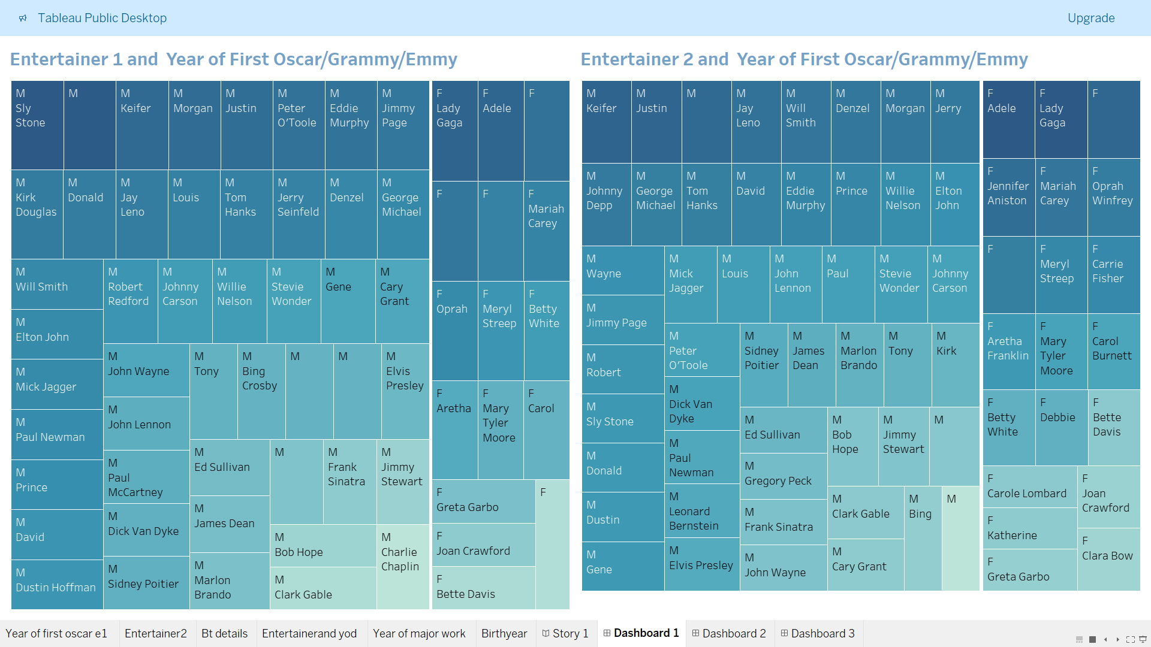
My dashboards Using Tableau

Slide 10
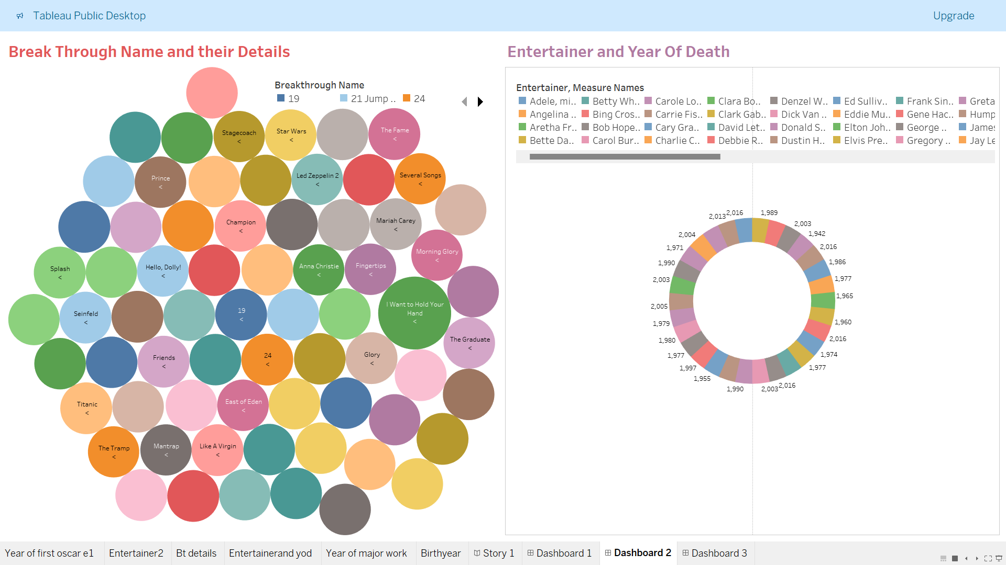

Slide 11
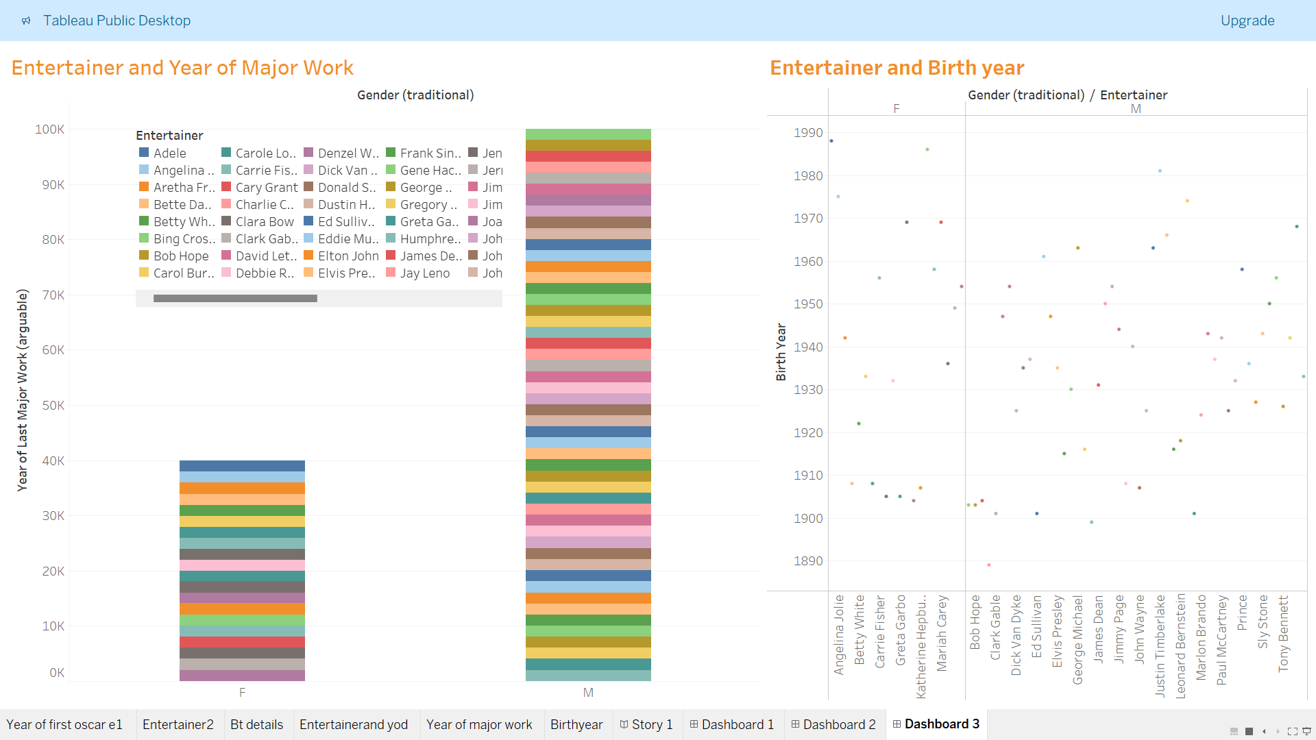

Slide 12


